Slide 1

Taming the Windows Module Loading for Stealthy Injection
A New Code Injection Technique
13th June 2025
Hugo Valette

Slide 2
This presentation is being conducted in my personal capacity and reflects my own views and opinions. It is not intended to represent the views, positions, or policies of my employer, or any other organization with which I am affiliated. The information provided is for educational and informational purposes only and should not be construed as professional advice. Any references to specific products, services, or companies are for illustrative purposes only and do not constitute an endorsement or recommendation

Slide 3
Obligatory whoami

Slide 4
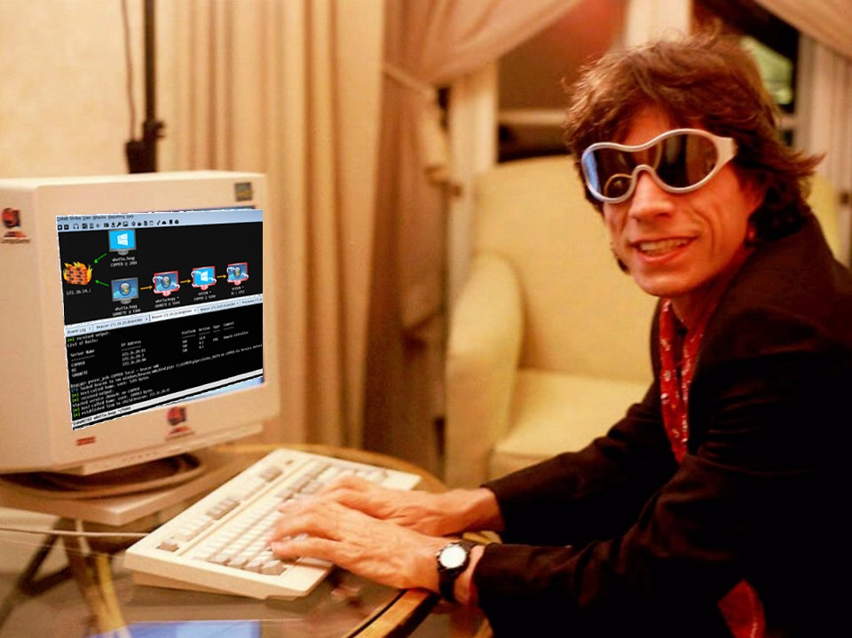
# WHOAMI
Hugo /@rwxstoned
Adversary Emulation
Some Blue Team background too
Blog: rwxstoned.github.io

Slide 5
Code Injection Landscape

Slide 6

# CODE INJECTION LANDSCAPE
Middle Ages

Slide 7
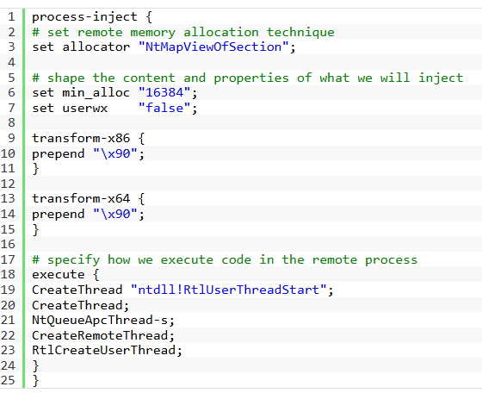
# CODE INJECTION LANDSCAPE
Industrial Revolution
https://www.cobaltstrike.com/blog/cobalt-strikes-process-injection-the-details-cobalt-strike

Slide 8
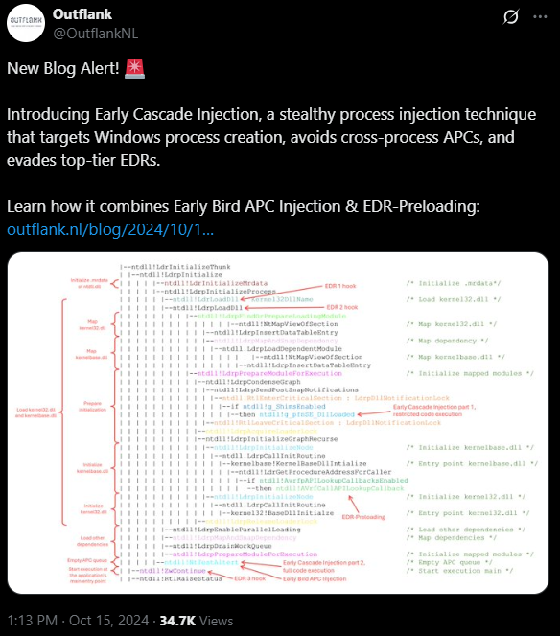
# CODE INJECTION LANDSCAPE
Space Exploration
https://www.outflank.nl/blog/2024/10/15/introducing-early-cascade-injection-from-windows-process-creation-to-stealthy-injection/

Slide 9

# CODE INJECTION LANDSCAPE
Most legacy techniques rely on 3 ingredients
Write Code
Fix Memory (if needed)
Trigger
VirtualProtectEx()
CreateRemoteThread()
VirtualAllocEx()/WriteProcessMemory()

Slide 10


# CODE INJECTION LANDSCAPE
EDRs seem to rely mostly on the trigger step for detection
VirtualProtectEx()
CreateRemoteThread()
VirtualAllocEx()/WriteProcessMemory()

Slide 11
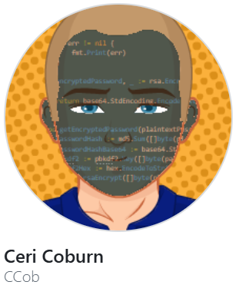
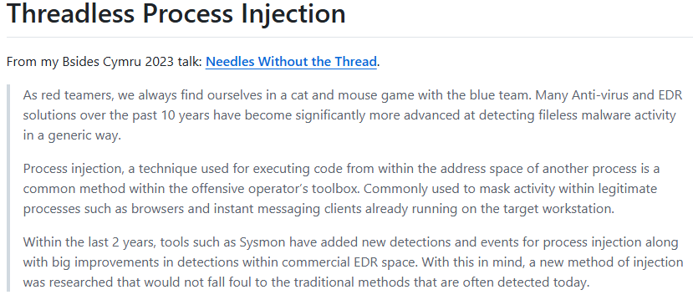
# CODE INJECTION LANDSCAPE
An outlier though: Threadless Injection (Ceri Coburn)
https://github.com/CCob/ThreadlessInject

Slide 12
# CODE INJECTION LANDSCAPE
## Active vs Passive techniques
Recent shift from active injection techniques to passive ones
Stealthier but higher maintenance in terms of development
Catch’ em all: https://github.com/itaymigdal/awesome-injection?tab=readme-ov-file#process-injection-1

Slide 13
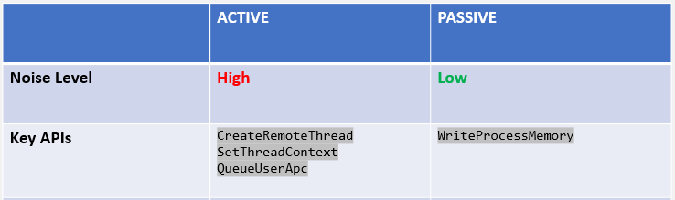
# CODE INJECTION LANDSCAPE
## Active vs Passive techniques
We actively tamper with the intended execution flow

Slide 14
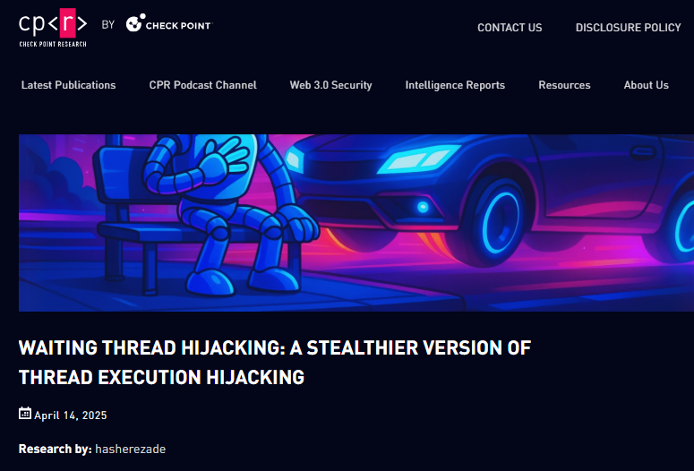
# CODE INJECTION LANDSCAPE
## Active vs Passive techniques
“Passive” injection technique
Recent Release (@hasherezade, April 2025):
https://research.checkpoint.com/2025/waiting-thread-hijacking/

Slide 15
This Talk’s Approach

Slide 16
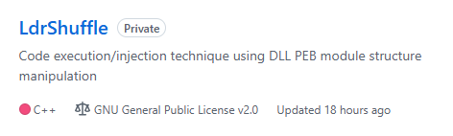
# THIS TALK’S APPROACH
Provide PoC and framework for a new passive code execution / injection technique.
  API Proxying: call an API indirectly (not traced back to your implant)
  Process Injection: execute code in a separate process

Slide 17


# THIS TALK’S APPROACH
Write Payload
Fix Memory (if needed)
Trigger Overwrite an address used by Windows’ internals
Wait for it to be run “naturally”.
Clean callstack
Decorrelation in your attack chain

Slide 18
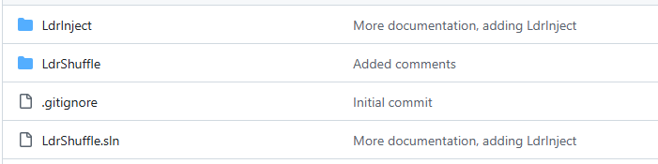
# THIS TALK’S APPROACH
The same idea can be applied within the same process, or in a remote one
Two use cases in the repository:
  API Proxying (same process)
  Process Injection (remote process)

Slide 19
DLLs in Windows

Slide 20
# DLLs IN WINDOWS
This is a 45 minutes talk so we won’t go through the next slide

Slide 21
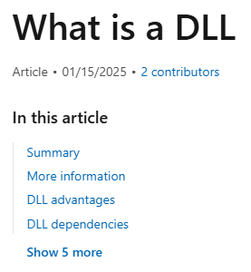
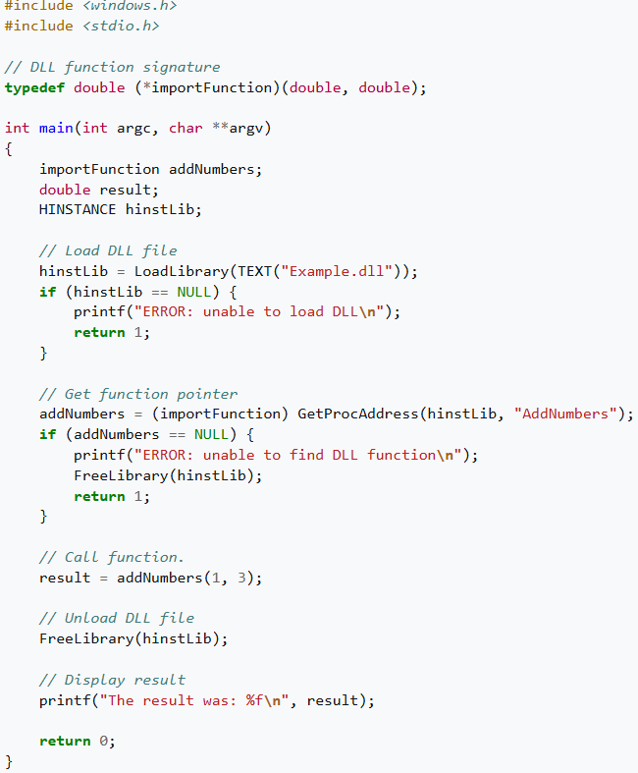
A dynamic-link library (DLL) is a shared library in the Microsoft Windows or OS/2 operating system. A DLL can contain executable code (functions), data, and resources.
A DLL file often has file extension .dll even though this is not required. The extension is sometimes used to describe the content of the file. For example, .ocx is a common extension for an ActiveX control and .drv for a legacy (16-bit) device driver.
A DLL that contains only resources can be called a resource DLL. Examples include an icon library, with common extension .icl, and a font library with common extensions .fon and .fot.
The file format of a DLL is the same as for an executable (a.k.a. EXE). The main difference between a DLL file and an EXE file is that a DLL cannot be run directly since the operating system requires an entry point to start execution. Windows provides a utility program (RUNDLL.EXE/RUNDLL32.EXE) to execute a function exposed by a DLL. Since they have the same format, an EXE can be used as a DLL. Consuming code can load an EXE via the same mechanism as loading a DLL.
Symbol resolution and binding
Each function exported by a DLL is identified by a numeric ordinal and optionally a name. Likewise, functions can be imported from a DLL either by ordinal or by name. The ordinal represents the position of the function's address pointer in the DLL Export Address table. It is common for internal functions to be exported by ordinal only. For most Windows API functions only the names are preserved across different Windows releases; the ordinals are subject to change. Thus, one cannot reliably import Windows API functions by their ordinals.
Importing functions by ordinal provides only slightly better performance than importing them by name: export tables of DLLs are ordered by name, so a binary search can be used to find a function. The index of the found name is then used to look up the ordinal in the Export Ordinal table. In 16-bit Windows, the name table was not sorted, so the name lookup overhead was much more noticeable.
It is also possible to bind an executable to a specific version of a DLL, that is, to resolve the addresses of imported functions at compile-time. For bound imports, the linker saves the timestamp and checksum of the DLL to which the import is bound. At run-time, Windows checks to see if the same version of library is being used, and if so, Windows bypasses processing the imports. Otherwise, if the library is different from the one which was bound to, Windows processes the imports in a normal way.
Bound executables load somewhat faster if they are run in the same environment that they were compiled for, and exactly the same time if they are run in a different environment, so there is no drawback for binding the imports. For example, all the standard Windows applications are bound to the system DLLs of their respective Windows release. A good opportunity to bind an application's imports to its target environment is during the application's installation. This keeps the libraries "bound" until the next OS update. It does, however, change the checksum of the executable, so it is not something that can be done with signed programs, or programs that are managed by a configuration management tool that uses checksums (such as MD5 checksums) to manage file versions. As more recent Windows versions have moved away from having fixed addresses for every loaded library (for security reasons), the opportunity and value of binding an executable is decreasing.
Memory management
In Windows API, DLL files are organized into sections. Each section has its own set of attributes, such as being writable or read-only, executable (for code) or non-executable (for data), and so on.
The code in a DLL is usually shared among all the processes that use the DLL; that is, they occupy a single place in physical memory, and do not take up space in the page file. Windows does not use position-independent code for its DLLs; instead, the code undergoes relocation as it is loaded, fixing addresses for all its entry points at locations which are free in the memory space of the first process to load the DLL. In older versions of Windows, in which all running processes occupied a single common address space, a single copy of the DLL's code would always be sufficient for all the processes. However, in newer versions of Windows which use separate address spaces for each program, it is only possible to use the same relocated copy of the DLL in multiple programs if each program has the same virtual addresses free to accommodate the DLL's code. If some programs (or their combination of already-loaded DLLs) do not have those addresses free, then an additional physical copy of the DLL's code will need to be created, using a different set of relocated entry points. If the physical memory occupied by a code section is to be reclaimed, its contents are discarded, and later reloaded directly from the DLL file as necessary.
In contrast to code sections, the data sections of a DLL are usually private; that is, each process using the DLL has its own copy of all the DLL's data. Optionally, data sections can be made shared, allowing inter-process communication via this shared memory area. However, because user restrictions do not apply to the use of shared DLL memory, this creates a security hole; namely, one process can corrupt the shared data, which will likely cause all other sharing processes to behave undesirably. For example, a process running under a guest account can in this way corrupt another process running under a privileged account. This is an important reason to avoid the use of shared sections in DLLs.
If a DLL is compressed by certain executable packers (e.g. UPX), all of its code sections are marked as read and write, and will be unshared. Read-and-write code sections, much like private data sections, are private to each process. Thus DLLs with shared data sections should not be compressed if they are intended to be used simultaneously by multiple programs, since each program instance would have to carry its own copy of the DLL, resulting in increased memory consumption.
Import libraries
Like static libraries, import libraries for DLLs are noted by the .lib file extension. For example, kernel32.dll, the primary dynamic library for Windows's base functions such as file creation and memory management, is linked via kernel32.lib. The usual way to tell an import library from a proper static library is by size: the import library is much smaller as it only contains symbols referring to the actual DLL, to be processed at link-time. Both nevertheless are Unix ar format files.
Linking to dynamic libraries is usually handled by linking to an import library when building or linking to create an executable file. The created executable then contains an import address table (IAT) by which all DLL function calls are referenced (each referenced DLL function contains its own entry in the IAT). At run-time, the IAT is filled with appropriate addresses that point directly to a function in the separately loaded DLL.[3]
In Cygwin/MSYS and MinGW, import libraries are conventionally given the suffix .dll.a, combining both the Windows DLL suffix and the Unix ar suffix. The file format is similar, but the symbols used to mark the imports are different (_head_foo_dll vs __IMPORT_DESCRIPTOR_foo).[4] Although its GNU Binutils toolchain can generate import libraries and link to them, it is faster to link to the DLL directly.[5] An experimental tool in MinGW called genlib can be used to generate import libs with MSVC-style symbols.

Slide 22
# DLLs IN WINDOWS
Let’s focus on a few key aspects of a DLL lifecycle in Windows

Slide 23
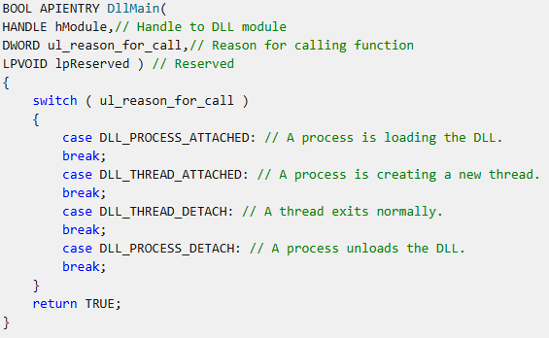
# DLLs IN WINDOWS
4
It’s a piece of code, which will be called by Windows under certain circumstances:
certain
Not always invoked. Windows will not call DllMain() for thread creation/destruction for certain modules.

Slide 24
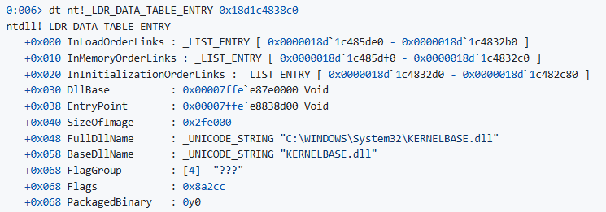

# DLLs IN WINDOWS
Each process maintains a record of each DLL loaded, with its properties, for instance:
Its name
Its name again
A load time
A load reason
The DLL base
Its EntryPoint
…
Links to the following list item
DontCallForThreads (cf. previous slide)
https://github.com/bats3c/DarkLoadLibrary

Slide 25
# DLLs IN WINDOWS

Slide 26




# DLLs IN WINDOWS
Let’s summarize
An EntryPoint value tells Windows where to find the DllMain() to execute everytime one of the following happens:
Process Creation (not interesting)
Process Destruction (not interesting)
Thread Destruction* (interesting but sounds risky)
Thread Creation* (interesting)
* If DontCallForThreads = 0
For this DLL, DontCallForThreads = 0

Slide 27
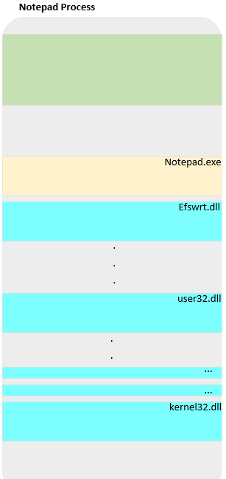

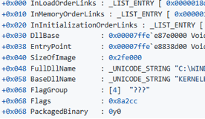

Where is that doubly-linked list ?
Heap[RW]
…
x
DllMain()
DllMain()
DllMain()

Slide 28
Weaponization

Slide 29
# WEAPONIZATION
## API PROXYING
The real challenge is not executing code. But:
Maintain stability: restore the EntryPoint we overwrote
Ensure we can pass input (arguments) and collect output [API proxying only]
Running in a DllMain() context has limitations

Slide 30
# WEAPONIZATION
## API PROXYING
Maintain stability: restore the EntryPoint we overwrote
Ensure we can pass input (arguments) and collect output [API proxying only]
Running in a DllMain() context has limitations

Slide 31

# WEAPONIZATION
## API PROXYING
Maintain stability: restore the EntryPoint we overwrote

Slide 32
# WEAPONIZATION
## API PROXYING
Maintain stability: restore the EntryPoint we overwrote
Ensure we can pass input (arguments) and collect output [API proxying only]
Running in a DllMain() context has limitations

Slide 33
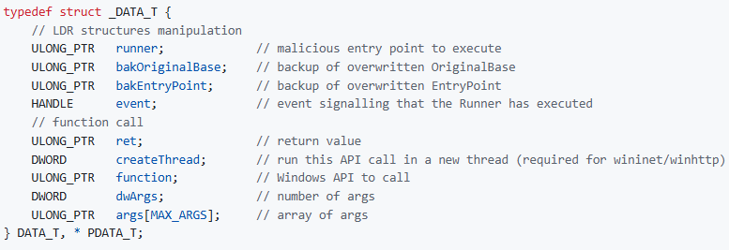
# WEAPONIZATION
## API PROXYING
Ensure we can pass input (arguments) and collect output [API proxying only]
Flow is diverted to Runner() which is simply a “helper” to perform the call we want.
We use this data structure (on the heap) to keep track of all parameters needed:

Slide 34
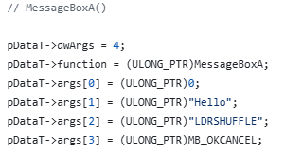
# WEAPONIZATION
## API PROXYING
Examples – running MessageBox

Slide 35
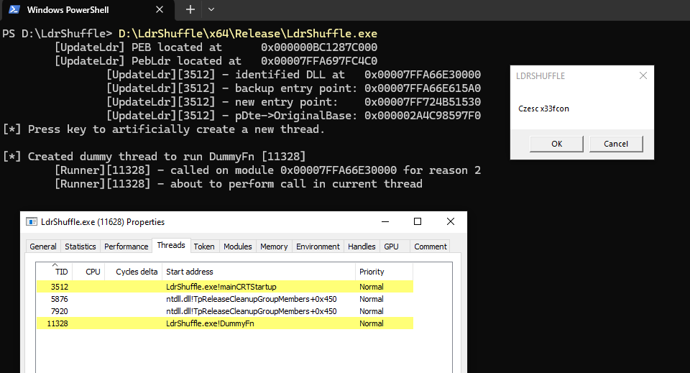

Slide 36
# WEAPONIZATION
## API PROXYING
Maintain stability: restore the EntryPoint we overwrote
Ensure we can pass input (arguments) and collect output (return value)
Running in a DllMain() context has limitations

Slide 37
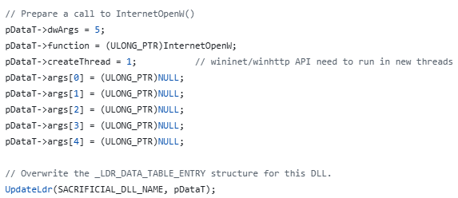
# WEAPONIZATION
## API PROXYING
Examples – a more complex API, InternetOpenW
Winhttp and Wininet APIs are complex and will run into thread-syncing issues if not run in a new thread.
https://learn.microsoft.com/en-us/windows/win32/dlls/dllmain

Slide 38
Can we do this with a remote process ?

Slide 39
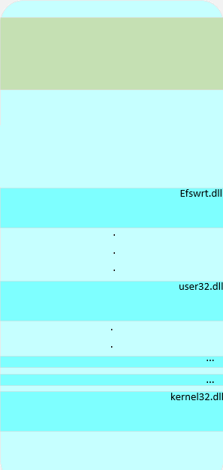
# WEAPONIZATION
## CROSS-PROCESS INJECTION
Chrome.exe
How does this translate to a separate process ?
…
x
Yes, with read-write operations:
Write payload somewhere
Walk the process’ PEB and identify suitable DLL
Modify its stored EntryPoint
Wait
payload
DllMain()

Slide 40
# WEAPONIZATION
## CROSS-PROCESS INJECTION
However, *what* you implant also has to include a code stub to address some constraints:
1. Restore overwritten EntryPoint
2. Run shellcode in a new thread
Code stub
payload
Threads sync deadlocks (wininet/winhttp functions) if trying to spin up a default Cobalt Strike beacon.
This demo is using a UDRL which starts up the beacon in a new thread (CreateThread())

Slide 41
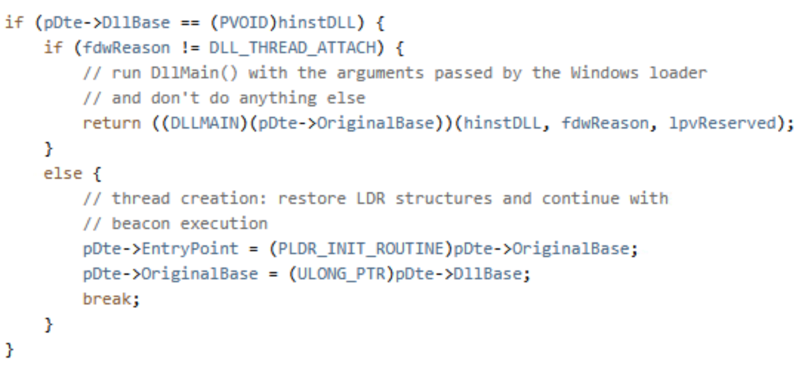
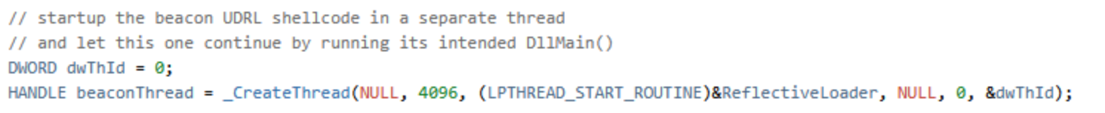
# WEAPONIZATION
## CROSS-PROCESS INJECTION
Code stub
Restore the overwritten values (stability)
Create a new thread to run the implant
payload

Slide 42
# WEAPONIZATION
## LIMITATIONS
Tested with chrome.exe, firefox.exe, iexplore.exe, explorer.exe, code.exe and a few other common apps…
However, reminder:
TEST !

Slide 43
Demo

Slide 44
Thank You !

